Slide 1

WHAT IS YAML
BASICS

Slide 2
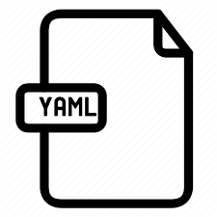
Content 01
WHAT IS YAML?
YAML Ain’t Markup Language.
Used for writing Playbooks
In other words YAML is nothing but, Configuration management language.
WHY WE USE YAML?
Because it is human readable, and many packages can also be Installed in yaml.
.yml

Slide 3

Uses of yaml
Mainly yaml file is used to describe data.
Best benefit of YAML is can be translated to multiple language types
Default configuration file format used by Ansible, Google App engine, etc.
It is used for optimizing Configuration files, log files, data serialization etc..
Yaml is commonly used for storing of data and transmission of data

Slide 4
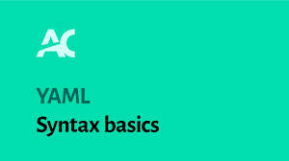
BASICS OF YAML(ex of dictionary or hash starts with a dash and space "- ")
- - -
- name: sampleplaybook
hosts: target host(or) hosts name specified in inventory (or) ip
user: root
tasks:
- name: copy file
copy:
src:
dest:

Slide 5
Different EXAMPLES
example( key:value)
# An employee record
company:
name: HCL
city: Alaska
branch: Belcon
example(Combination of dictionary and key:value)
- Supermarket:
name: Avanthi
address: shanti nagar
items:
- Wheat flour
- Rice
- pulses

Slide 6
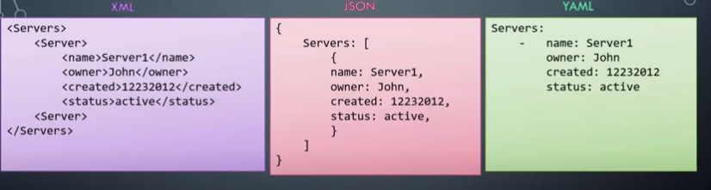
Differences between xml, json, yaml

Slide 7
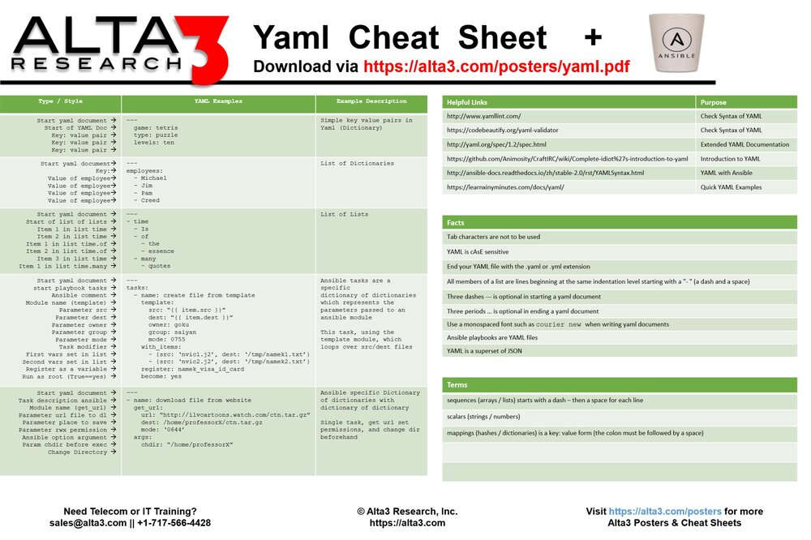
Cheat sheet

Slide 8
WHAT IS INVENTORY
Inventory = hosts + group of hosts
Commands, Modules, playbooks and tasks in playbooks will operate the results on hosts
Our inventory file resides inside in /etc/Ansible
To run ansible-playbook filename.yml –i inventory

Slide 9

Thank you!
Flora@contoso.com
http://www.contoso.com/

